Slide 1
Using the new birkbeck powerpoint template

Slide 2
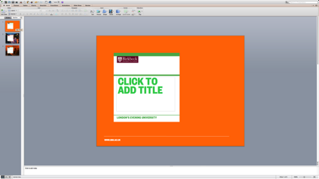
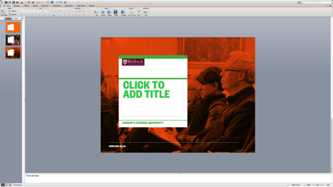
TITLE SLIDE OPTIONS
There are three different types of Title Slides for your to choose from.
Title Slide Coloured
Title Slide Image
Title Slide Duotone

Slide 3
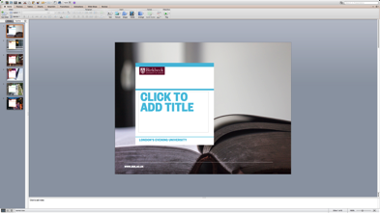
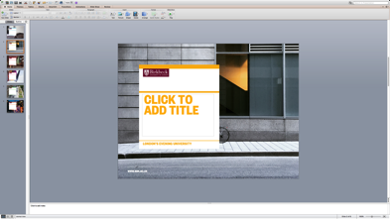
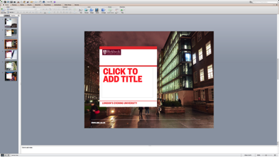
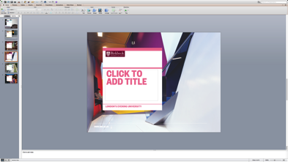
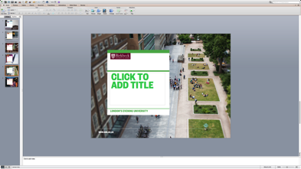
TITLE SLIDE COLOUR OPTIONS
Within each of the Title Slide options there is a range of colours to choose from.
Blue
Yellow
Red
Pink
Green
Orange

Slide 4
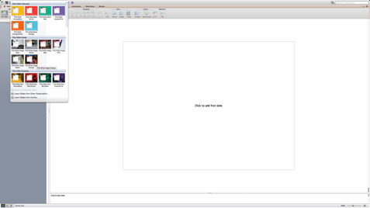
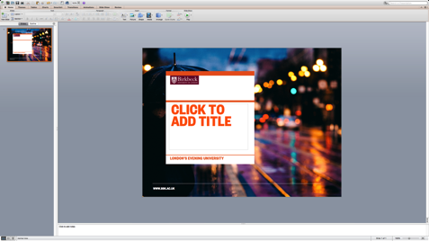
ADDING A TITLE SLIDE
Click on the New Slide icon in the top left hand corner and select a title slide from the three different groups of title slide options.
Click into the text field of the newly added title slide to alter the title text.
NB This text should auto adjust in size to match the title length.

Slide 5
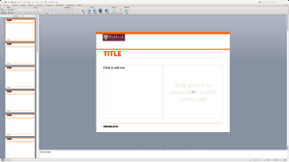
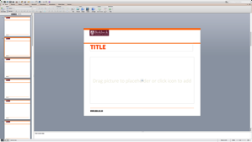
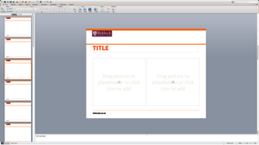
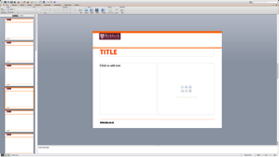
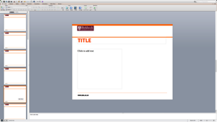
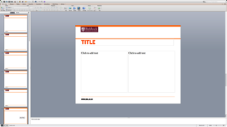
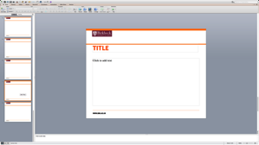
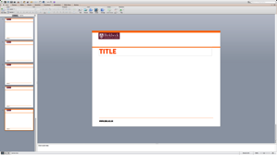
Content SLIDE OPTIONS
There are eight different types of Content Slides for your to choose from.
Text and Photo
Photo Large
Two Photos
Text and Content Box
Text Left
Two Textbox
Text Box Large
Blank Space

Slide 6
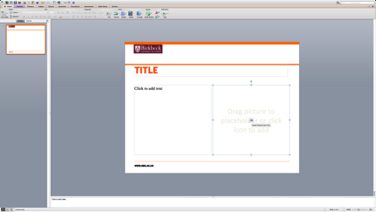
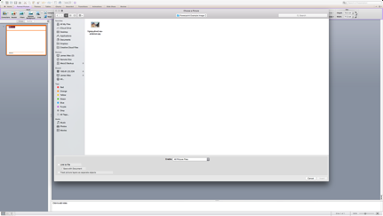
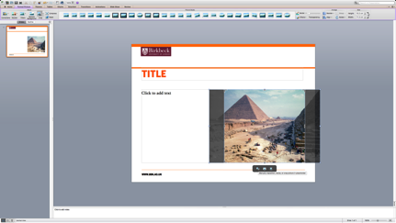
Inserting images
Click on the Picture Icon in the
image box.
Locate the image that you which to insert and select Insert.
If you need to resize or reframe your image select the CROP tool and then begin adjusting the image.

Slide 7
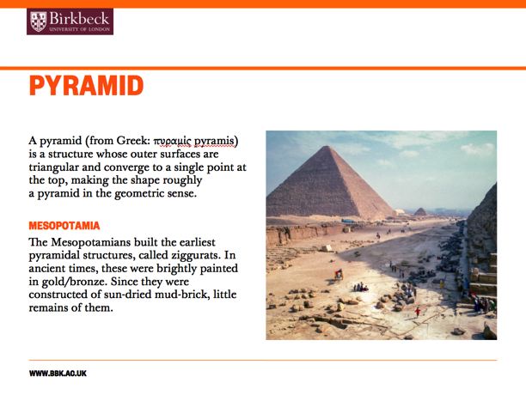
Adding TExt
To add a title click into
the Title Text field.
The text is automatically set to Birkbeck’s Title typeface, Founders Condensed.
NB If adding additional subtitle please ensure that are in the Founders Condensed typeface, in block capitals. All subtitle will also need to match the colour of the Content Slide that you are using.
To add body text click into
the any text field (other than
the Title Field).
The text is automatically set to Birkbeck’s Body typeface, Baskerville 10 Pro.

